Slide 1
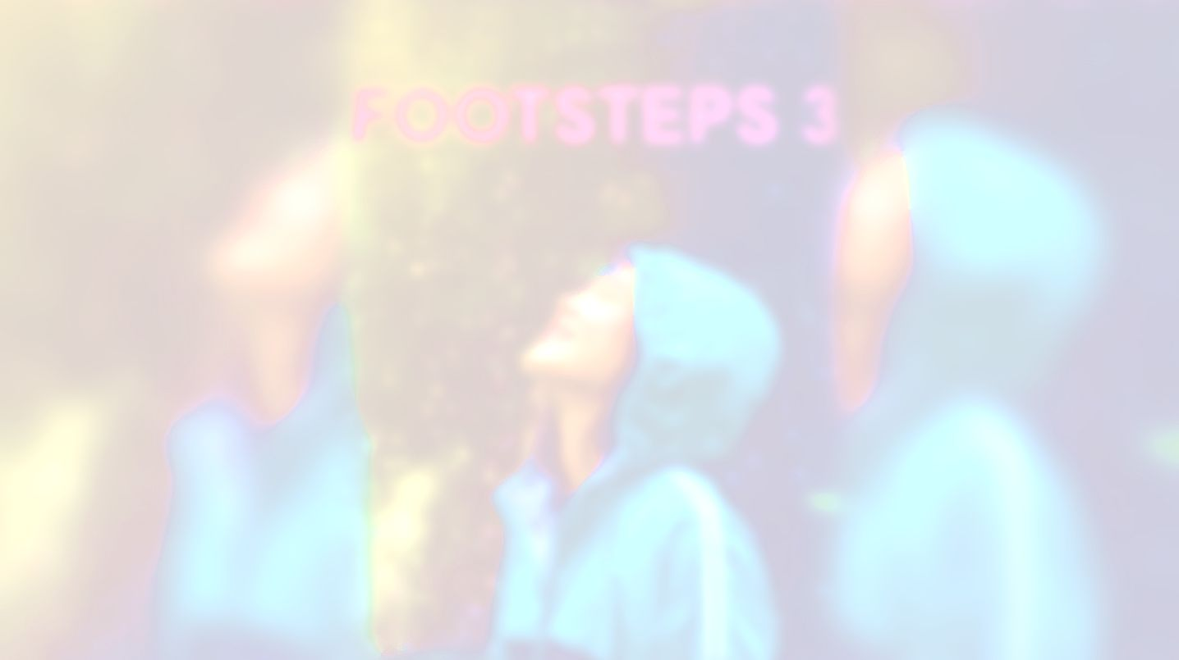
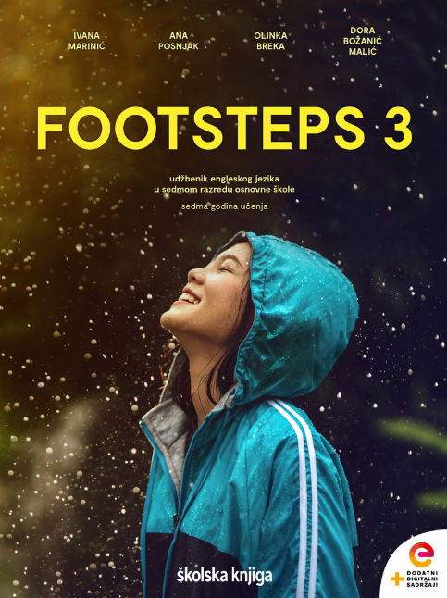

UNIT 4;
Earth Matters
Ecological Footprint

Slide 2
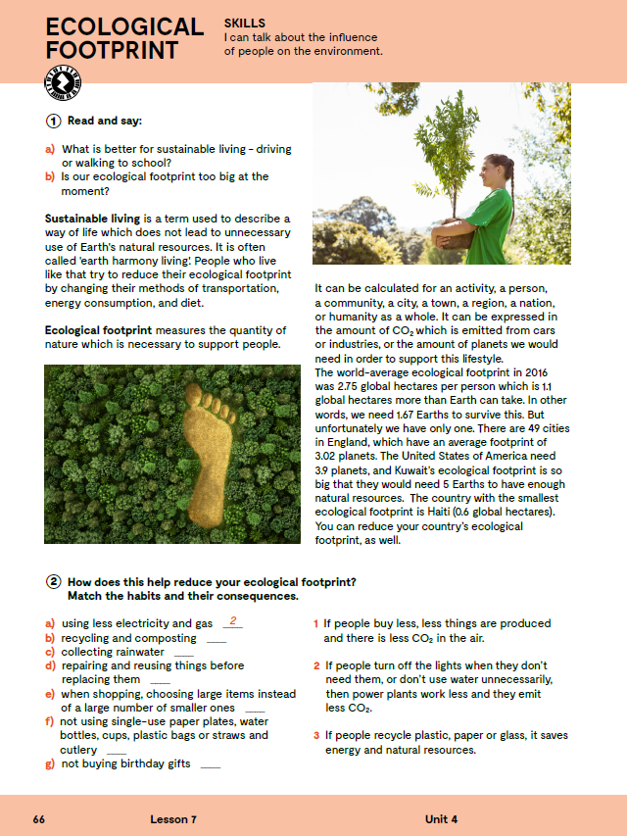
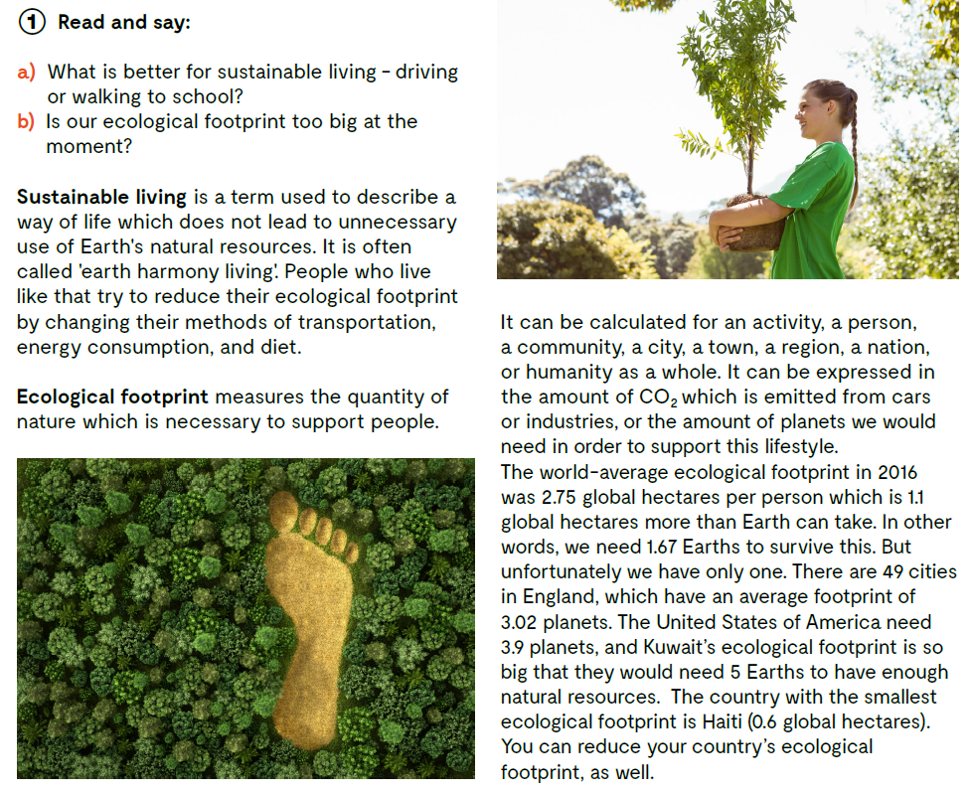
Translate:
sustainable living
ecological footprint
How can you reduce your ecological footprint?
What does the ecological footprint measure?
održivi način života
ekološki otisak

Slide 3

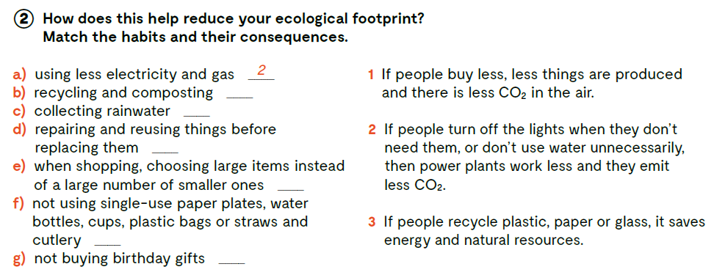
3
2
1
1
3
1

Slide 4
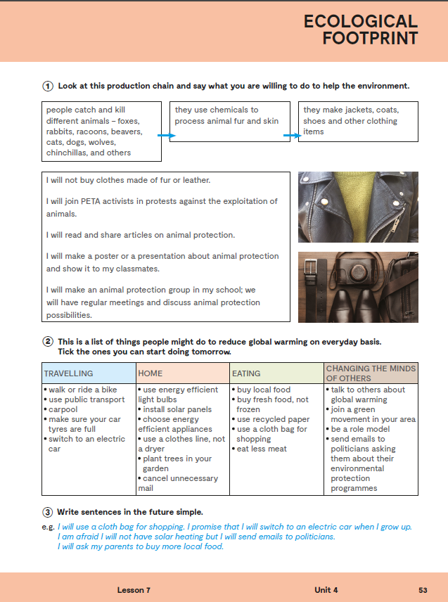
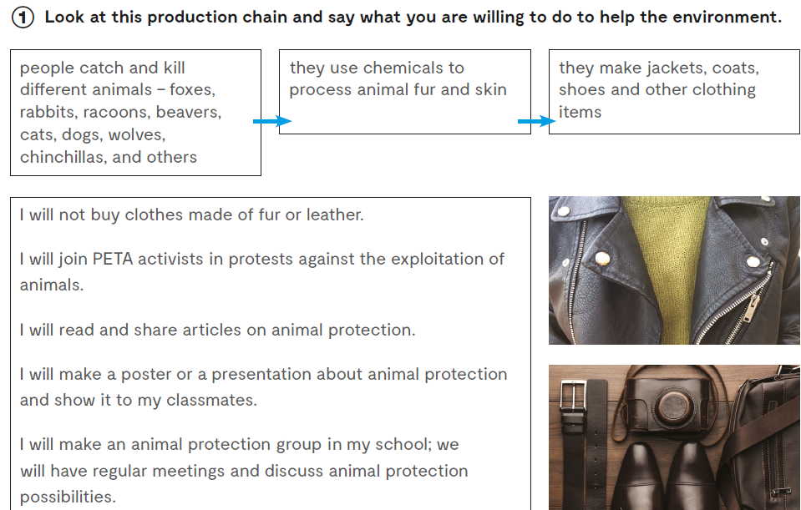
Workbook, p. 53

Slide 5
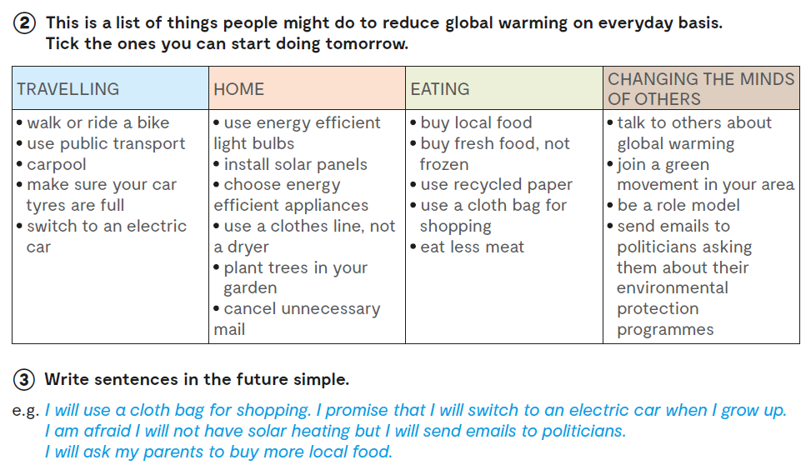

Slide 6
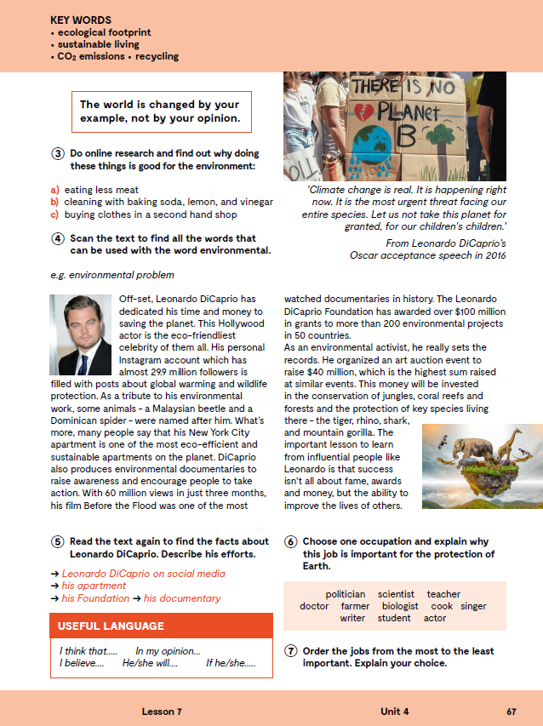
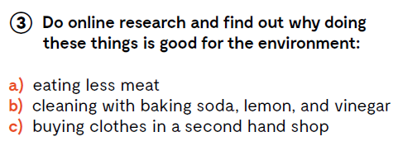
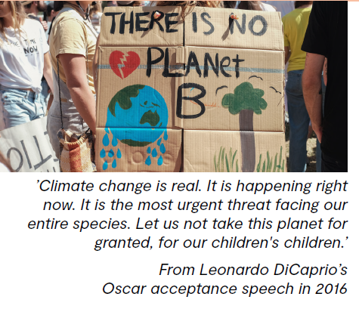


Slide 7

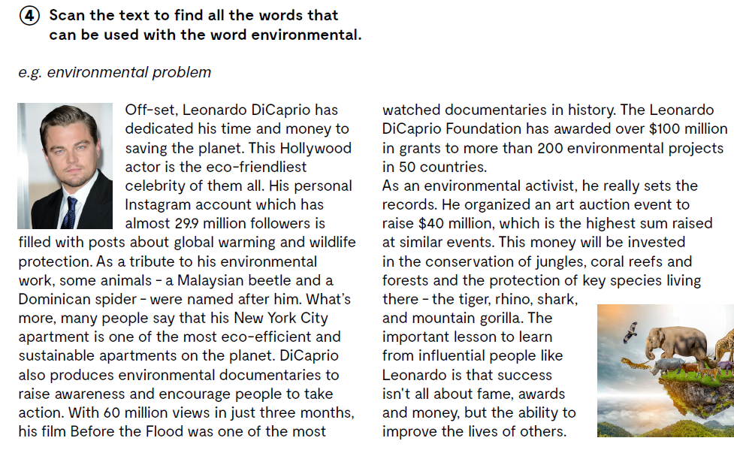
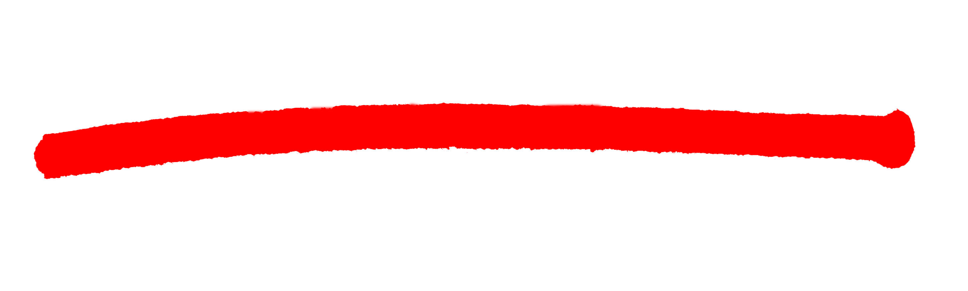
To su COLLOCATIONS, odnosno riječi koje stoje zajedno u rečenici.

Slide 8
What has Leonardo Di Caprio done off--set?
How many followers has he got?
What is his Instagram account filled with?
What does he produce?

Slide 9
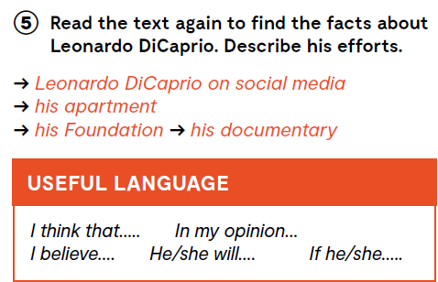

Slide 10

LEARN MORE
https://www.e-sfera.hr/dodatni-digitalni-sadrzaji/6be5db7e-acc0-4efb-b70f-4f68f7493ba0/
Green Hollywood stars

Slide 11
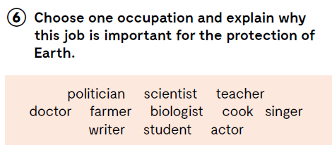

Let’s practise:
https://wordwall.net/play/843/549/667

Slide 12
